Slide 1

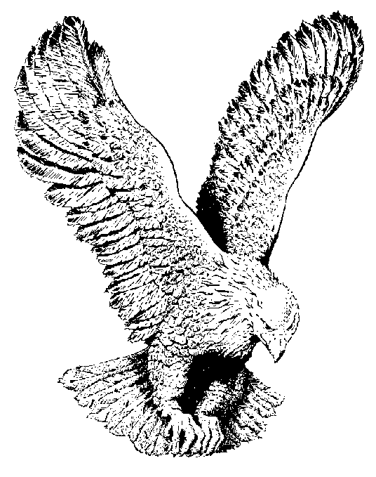
518 WE ARE WORSHIPPING
We are (I am) worshipping under the blood (3x)
Where the devil can do us (me) no harm
No harm, No harm, No harm
No harm, No harm, No harm
We are (I am) worshipping under the blood
Where the devil can do us (me) no harm.

